Slide 1
Hierarchical clustering
Attention:
1. Deadline for submission of Home Work report is December 3, 2018
2. Final mark: 0.7Exam_Mark + 0.3HW_Mark

Slide 2
Contents
Cluster hierarchy: a binary rooted tree with a height function, whose leaves are one-to-one labeled by dataset entities
Agglomerative clustering algorithm
Two distance between clusters measures:
Ward distance
Nearest Neighbor distance
Derivation of Ward cluster-to-cluster distance as the increment of the K-means square error criterion at the cluster merger
Max/Min Spanning Tree and Prim’s algorithm (with an example)
NN Divisive clustering with MST (with an example)

Slide 3
Cluster Hierarchy: Binary rooted tree
Over data set as the leaf set
Interior nodes: clusters of leaves; say F={AV,AN,AS}
Height function defined at all nodes
h(leaf)=0,
if t ⊂ s, then h(t)<h(s)
F G H
AV AN AS BA BR BU CI CY

Slide 4
Two types of algorithms: agglomerative (bottom-up) divisive (up-down)

Slide 5
Two types of criteria (among many others): Square error Nearest Neighbor

Slide 6
Agglomerative clustering, 1
Step 1: Start –
Trivial partition of the set of objects represented by their indices in N singletons:
Partition S={{1}, {2}, …, {i}, …, {N}},
(Dis)similarity function D=(d(i,j)), i,j= 1, 2,…, N (either distances or similarities from the object-to-feature data, or raw network interaction data)

Slide 7
Agglomerative clustering, 2
General step: given m part partition S ={S1, S2,…, Sm} and between-cluster dis(similarity) function d(s,t) (s,t=1,…, m),
G1: Find s*, t* minimizing dissimilarity d(s,t) (maximizing similarity) – a costly operation
G2: Merge clusters Ss* and St* to form Ss*t*=Ss* ∪ St*
G3: Compute (dis)similarity between Ss*t* and every other cluster Su to form a new (dis)similarity matrix
G4: Define and compute value of height h(Ss*t*)
Test: Stopping condition. If Yes, stop; output the hierarchy. If not, m:= m-1 and go to G1.

Slide 8
Agglomerative clustering, 3
AgglClus Algorithms may differ by only this:
G3: Compute (dis)similarity between Ss*t* and every other cluster Su to form a new (dis)similarity matrix
Two most popular versions:
Nearest neighbor (according to dis(similarity) between the nearest points from clusters)
Ward algorithm (according to change in the square error criterion)
In both agglomerative and divisive versions

Slide 9
Ward algorithm, both divisive and agglomerative, is based on the so-called Ward distance
Nearest neighbor divisive algorithm
is based on Minimum (Maximum) Spanning
Tree (MST)

Slide 10
Ward distance between clusters S_{k} and S_{l} (to be derived further on)
This combines distance between cluster centers c_{k}, c_{l} and a factor depending on the distribution of objects between the clusters: the smaller the difference in sizes N_{k} and N_{l}, the larger the value of the factor.
At Ward divisive clustering, a cluster is split in two parts maximizing wd. At Ward agglomerative clustering, two clusters are merged to minimize wd. In both cases, a balanced partition is preferred.

Slide 11
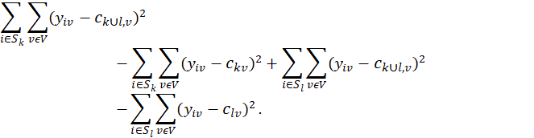
Derivation of Ward distance, 1:
Wd(S_{k},S_{l}) = W(S(k,l), c^{kl}) – W(S, c) =

Slide 12
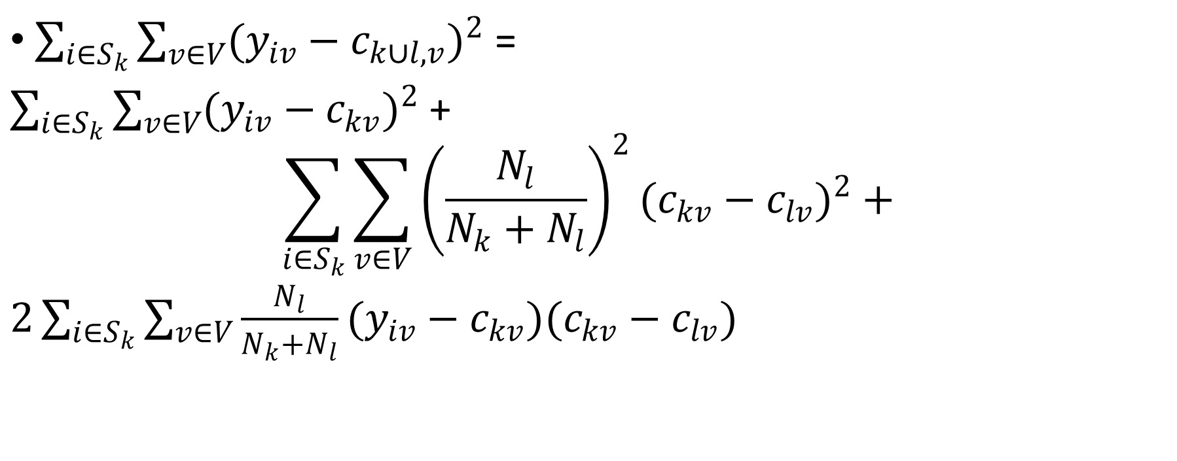
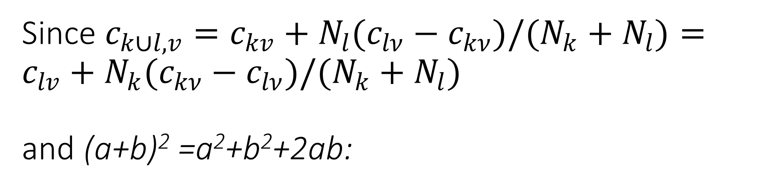
Since $c_{k∪l,v}=c_{kv}+N_{l}(c_{lν}−c_{kν})/(N_{k}+N_{l})=c_{lv}+N_{k}(c_{kν}−c_{lν})/(N_{k}+N_{l})$ and (a+b)² =a²+b²+2ab:
$\sum_{i∈S_{k}}{\sum_{v∈V}{(y_{iv}−c_{k∪l,v})^{2}}}$ =
$\sum_{i∈S_{k}}{\sum_{v∈V}{(y_{iv}−c_{kv})^{2}} }$+
$$\sum_{i∈S_{k}}{\sum_{v∈V}{{\left(\frac{N_{l}}{N_{k}+N_{l}}\right)}^{2}(c_{kv}−c_{lv})^{2}+}}$$
$2\sum_{i∈S_{k}}{\sum_{v∈V}{\frac{N_{l}}{N_{k}+N_{l}}(y_{iv}−c_{kv})(c_{kv}−c_{lv})}}$

Slide 13
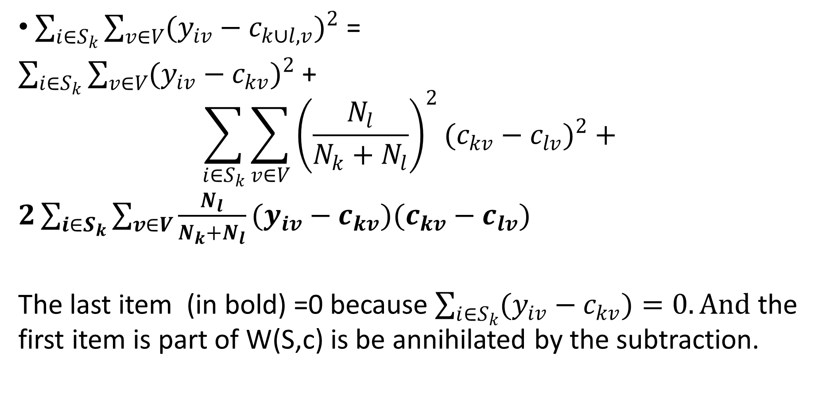
As proven above,
$\sum_{i∈S_{k}}{\sum_{v∈V}{(y_{iv}−c_{k∪l,v})^{2}}}$ =
$\sum_{i∈S_{k}}{\sum_{v∈V}{(y_{iv}−c_{kv})^{2}} }$+
$$\sum_{i∈S_{k}}{\sum_{v∈V}{{\left(\frac{N_{l}}{N_{k}+N_{l}}\right)}^{2}(c_{kv}−c_{lv})^{2}+}}$$
$2\sum_{i∈S_{k}}{\sum_{v∈V}{\frac{N_{l}}{N_{k}+N_{l}}(y_{iv}−c_{kv})(c_{kv}−c_{lv})}}$
The last item (in bold) =0 because $\sum_{i∈S_{k}}{(y_{iv}−c_{kv})=0.}And$ the first item is part of W(S,c) is be annihilated by the subtraction.

Slide 14
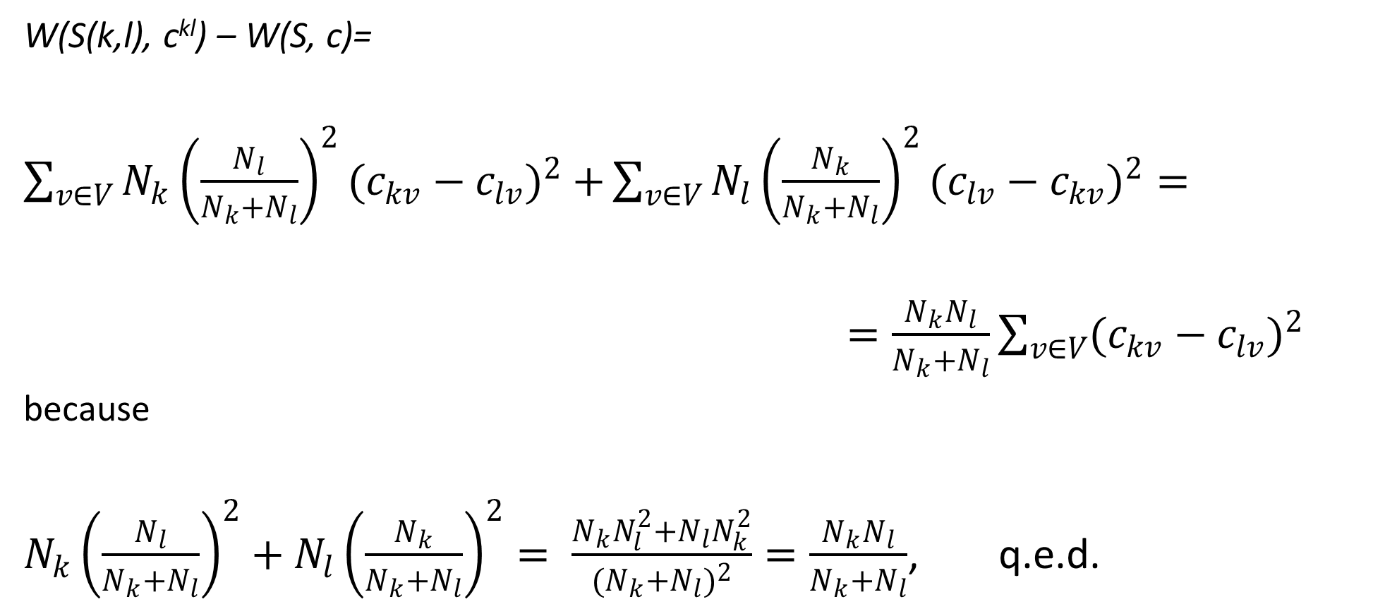
With a similar trick at S_{l,}
W(S(k,l), c^{kl}) – W(S, c)=
$\sum_{v∈V}{N_{k}{\left(\frac{N_{l}}{N_{k}+N_{l}}\right)}^{2}(c_{kv}−c_{lv})^{2}+}\sum_{v∈V}{N_{l}{\left(\frac{N_{k}}{N_{k}+N_{l}}\right)}^{2}(c_{lv}−c_{kv})^{2}=}$
$=\frac{N_{k}N_{l}}{N_{k}+N_{l}}\sum_{v∈V}{(c_{kv}−c_{lv})^{2}}$
because
$N_{k}{\left(\frac{N_{l}}{N_{k}+N_{l}}\right)}^{2}+N_{l}{\left(\frac{N_{k}}{N_{k}+N_{l}}\right)}^{2}= \frac{N_{k}N_{l}^{2}+N_{l}N_{k}^{2}}{{(N}_{k}+N_{l})^{2}}=\frac{N_{k}N_{l}}{N_{k}+N_{l}}$, q.e.d.

Slide 15
NN clustering relates to the graph-theoretic concept of Minimum Spanning Tree (MST), 1
Given a dissimilarity matrix, it can be represented by a weighted graph.
A tree is a subgraph with no cycles
A spanning tree is a tree whose node set coincides with the set of all objects
The length of a tree is the sum of weights of its edges
The minimum spanning tree is a spanning tree of maximum length.
If the data is a similarity matrix, we look for a maximum spanning tree.

Slide 16
NN clustering relates to the graph-theoretic concept of Minimum Spanning Tree (MST), 2
NN agglomerative clustering and NN divisive clustering over a (dis)similarity matrix
is equivalent to
agglomerative or divisive clustering
over its Min/Max spanning tree.

Slide 17
Prim’s algorithm for MST: Building MST T by adding nodes one-by-one (greedy)
1. Initialization.
Start with tree T consisting of an arbitrary node i∈I with no edges.
2. Tree update.
Find j∈ I-T maximizing a_{ij} over all i∈T and j∈I-T. Add j and edge {i,j} with the maximal a_{ij} to T.
3. Stop-condition.
If I-T=∅, halt and output tree T. Otherwise, go to 2.
Quest: What MST is built with this algorithm: Maximal or Minimal?

Slide 18
Example: Digits 0, 1, 2,…, 9 confusion data (symmetrized)
Stimulus | Response 1 2 3 4 5 6 7 8 9 0
1 2 3 4 5 6 7 8 9 0 | 877 11 18 86 9 20 165 6 15 11 11 782 38 13 31 31 9 29 18 11 18 38 681 6 31 4 31 29 132 11 86 13 6 732 9 11 26 13 44 6 9 31 31 9 669 88 7 13 104 11 20 31 4 11 88 633 2 113 11 31 165 9 31 26 7 2 667 6 13 16 6 29 29 13 13 113 6 577 75 122 15 18 132 44 104 11 13 75 550 32 11 11 11 6 11 31 16 122 32 818

Slide 19
Example: Digits 0, 1, 2,…, 9 confusion data as a graph (weights > 21)
6 0
88 31 113 122
31
5 2 29 8
38 29
31 75 32
104 3
31 132
9
7 26 44
4
165 1
86

Slide 20
Maximum ST to build
Start with arbitrary node. Let it be 0.
A. Find a node nearest to 0:
0 --- 8 (122) which is current T.
B. Find a node which is the nearest to either 0 or 8: 0---8(122)---6(113)
C. Find a node nearest to either 0 or 8 or 6: 0---8(122)---6(113)----5 (88)
D. Find a node nearest to 0, 8, 6, or 5:
0---8(122)---6(113)----5(88)----9(104)
E. Find a node which is the nearest to either of 0,8,6,5,9:
0--8(122)--6(113)--5(88)--9(104)--3 (132)
Quiz: Why Maximum ST?
6 0
88 31 113 122
31
5 2 29 8
38 29
31 75 32
104 3
31 132
9
7 26 44
4
165 1
86

Slide 21
Maximum ST built (see in red)
F. Find a node which is the nearest to either 0,8,6,5,9,3:
0---8(122)---6(113)----5(88)----9(104)----3 (132)
|
4 (44)
G. F. E. A node which is the nearest to either 0,8,6,5,9,3, 4:
0---8(122)---6(113)----5(88)----9(104)----3 (132)
|
4 (44)----1 (86)
2(38)
H. Final MST: |
0--8(122)--6(113)--5(88)--9(104)--3 (132)
|
4(44)--1 (86)–7 (165)
6 0
88 31 113 122
31
5 2 29 8
38 29
31 75 32
104 3
31 132
9
7 26 44
4
165 1
86

Slide 22
Convert an MST to a Nearest Neighbor Hierarchy/Partition
K-part partition: Cut K-1 weakest links
NN binary hierarchy: build a hierarchy top-down by cutting the weakest link at each step

Slide 23
NN Partition: at K=4, cut 3 weakest links
2(38)
|
0--8(122)--6(113)--5(88)--9(104)--3 (132)
|
4(44)--1 (86)–7 (165)

Slide 24
NN Hierarchy Divisively: Sort MST links, cut over the weakest link one by one
All 2(38)
All without “2” cut38
cut44
0--8--6--5--9--3 4--1–7
cut88 cut86
0--8—6 5—9--3 4 1—7
cut113 cut104
0—8 6 5 9—3 1 7
0 8 9 3

Slide 25
NN Hierarchy with a height function, say h(t)=170-cut(t)
All h axis
All without “2” cut38 2(38) 132
cut44
0--8--6--5--9--3 4--1–7 126
cut88 cut86
0--8—6 5—9--3 1—7
cut113 cut104
0—8 9—3
0 8 6 5 9 3 4 1 7 0

Slide 26
Summary of the lecture
Cluster hierarchy as a binary rooted tree with a height function, whose leaves are one-to-one labeled by dataset entities
Agglomerative clustering algorithm
Distance between clusters:
Ward distance
Nearest Neighbor distance
Derivation of Ward cluster-to-cluster distance as the increment of the K-means square error criterion at the cluster merger
Max/Min Spanning Tree and Prim’s algorithm
NN Divisive clustering with MST

